Slide 1

Internet of Things with the Raspberry Pi
Ruth Mills
Lead Developer
Connect Group
Twitter: @ruthmills
Web: www.ruthmills.me.uk

Slide 2
Internet of Things
Network-connected devices that either sense/monitor, control, or both
IoT devices are found in industry, offices, healthcare, transport (e.g. Connected Car), etc, as well as in the home.
In the home, examples include:
Wi-Fi connected light bulbs, e.g. Easybulb, Philips Hue, LiFX
Wi-Fi controlled electric sockets, e.g. WIFIPLUG, Belkin WeMo
Wi-Fi controlled heating, e.g. Nest, Hive, Drayton miGenie
Energy usage/Solar Generation monitoring, e.g. OpenEnergyMonitor, OWL, GreenEnergyOptions
Network connected white goods – e.g. fridges, washing machines, etc
Network connected entertainment, e.g. Netflix, Sonos, Squeezebox

Slide 3
The Problem
Getting all these devices from disparate manufacturers to work together
Each tends to come with its own smartphone app, usually for iOS and/or Android
But IoT devices are essentially all just network devices talking TCP/IP or UDP on your network
Many, e.g. WIFIPLUG, are reliant on a proprietary application running in the cloud
Security implications of having a cloud application controlling devices in your house

Slide 4
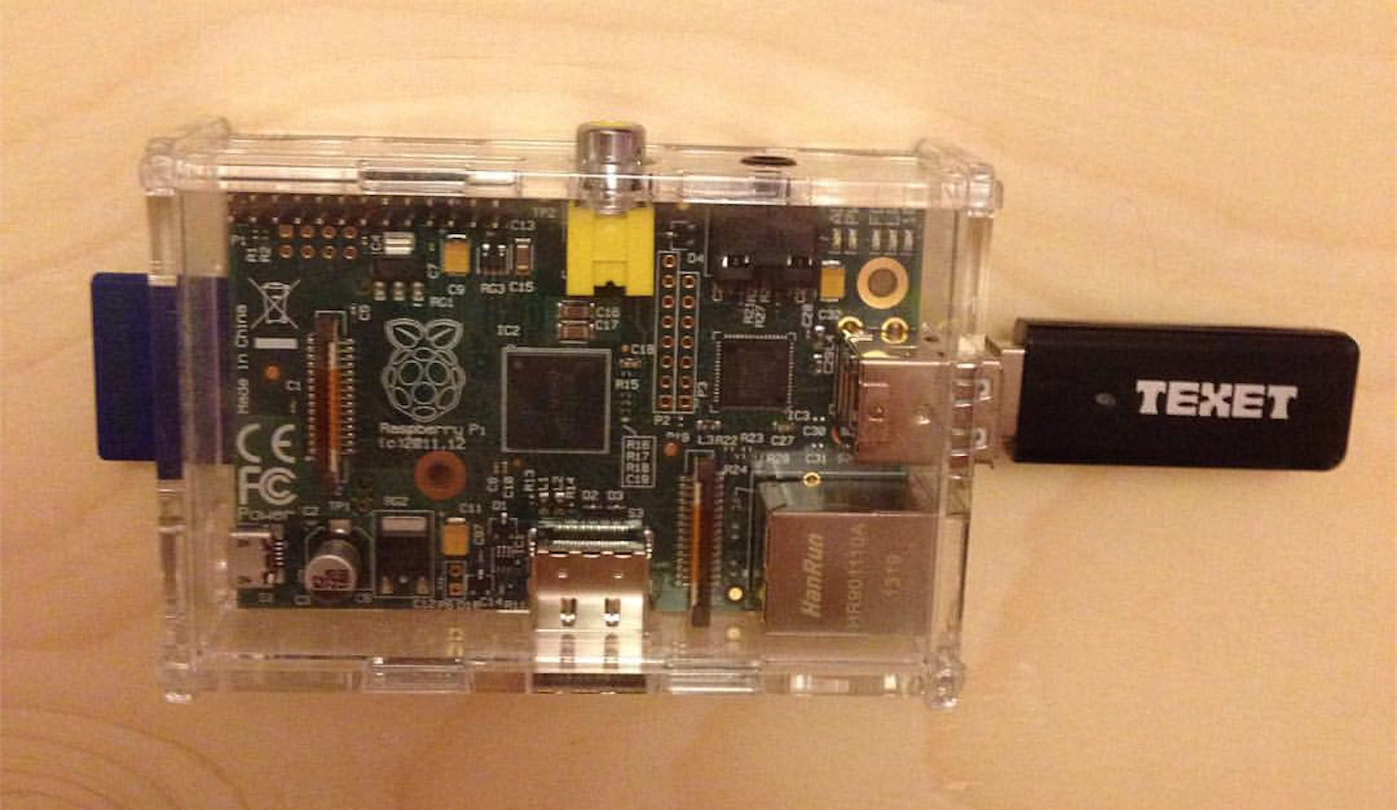
The Solution: The Raspberry Pi

Slide 5
Why use the Raspberry Pi?
Inexpensive and readily available
Open Source and Open Hardware
Low power consumption – can run 24/7
Wide choice of languages to code in – e.g. Python, C++, Perl, Java, Scratch, and many more!
Highly extensible – lots of hardware add-ons available, e.g. relay boards,temperature sensors, cameras, motors, Hi-Fi sound boards etc.
The only limit is your imagination!

Slide 6
Pi-Fi – Multi-Room Audio
The Raspberry Pi is great for making your own multi-room audio set-up too
Like Sonos, only a lot less expensive
Logitech Media Server runs great on the Raspberry Pi 2 and 3 – with the Pidora distribution, it's as easy as: yum install logitechmediaserver to install it!
Squeezelite is a lightweight Logitech Squeezebox emulator that will even run on an old Raspberry Pi Model B – and is very easy to install on Raspbian: sudo apt-get install squeezelite

Slide 7
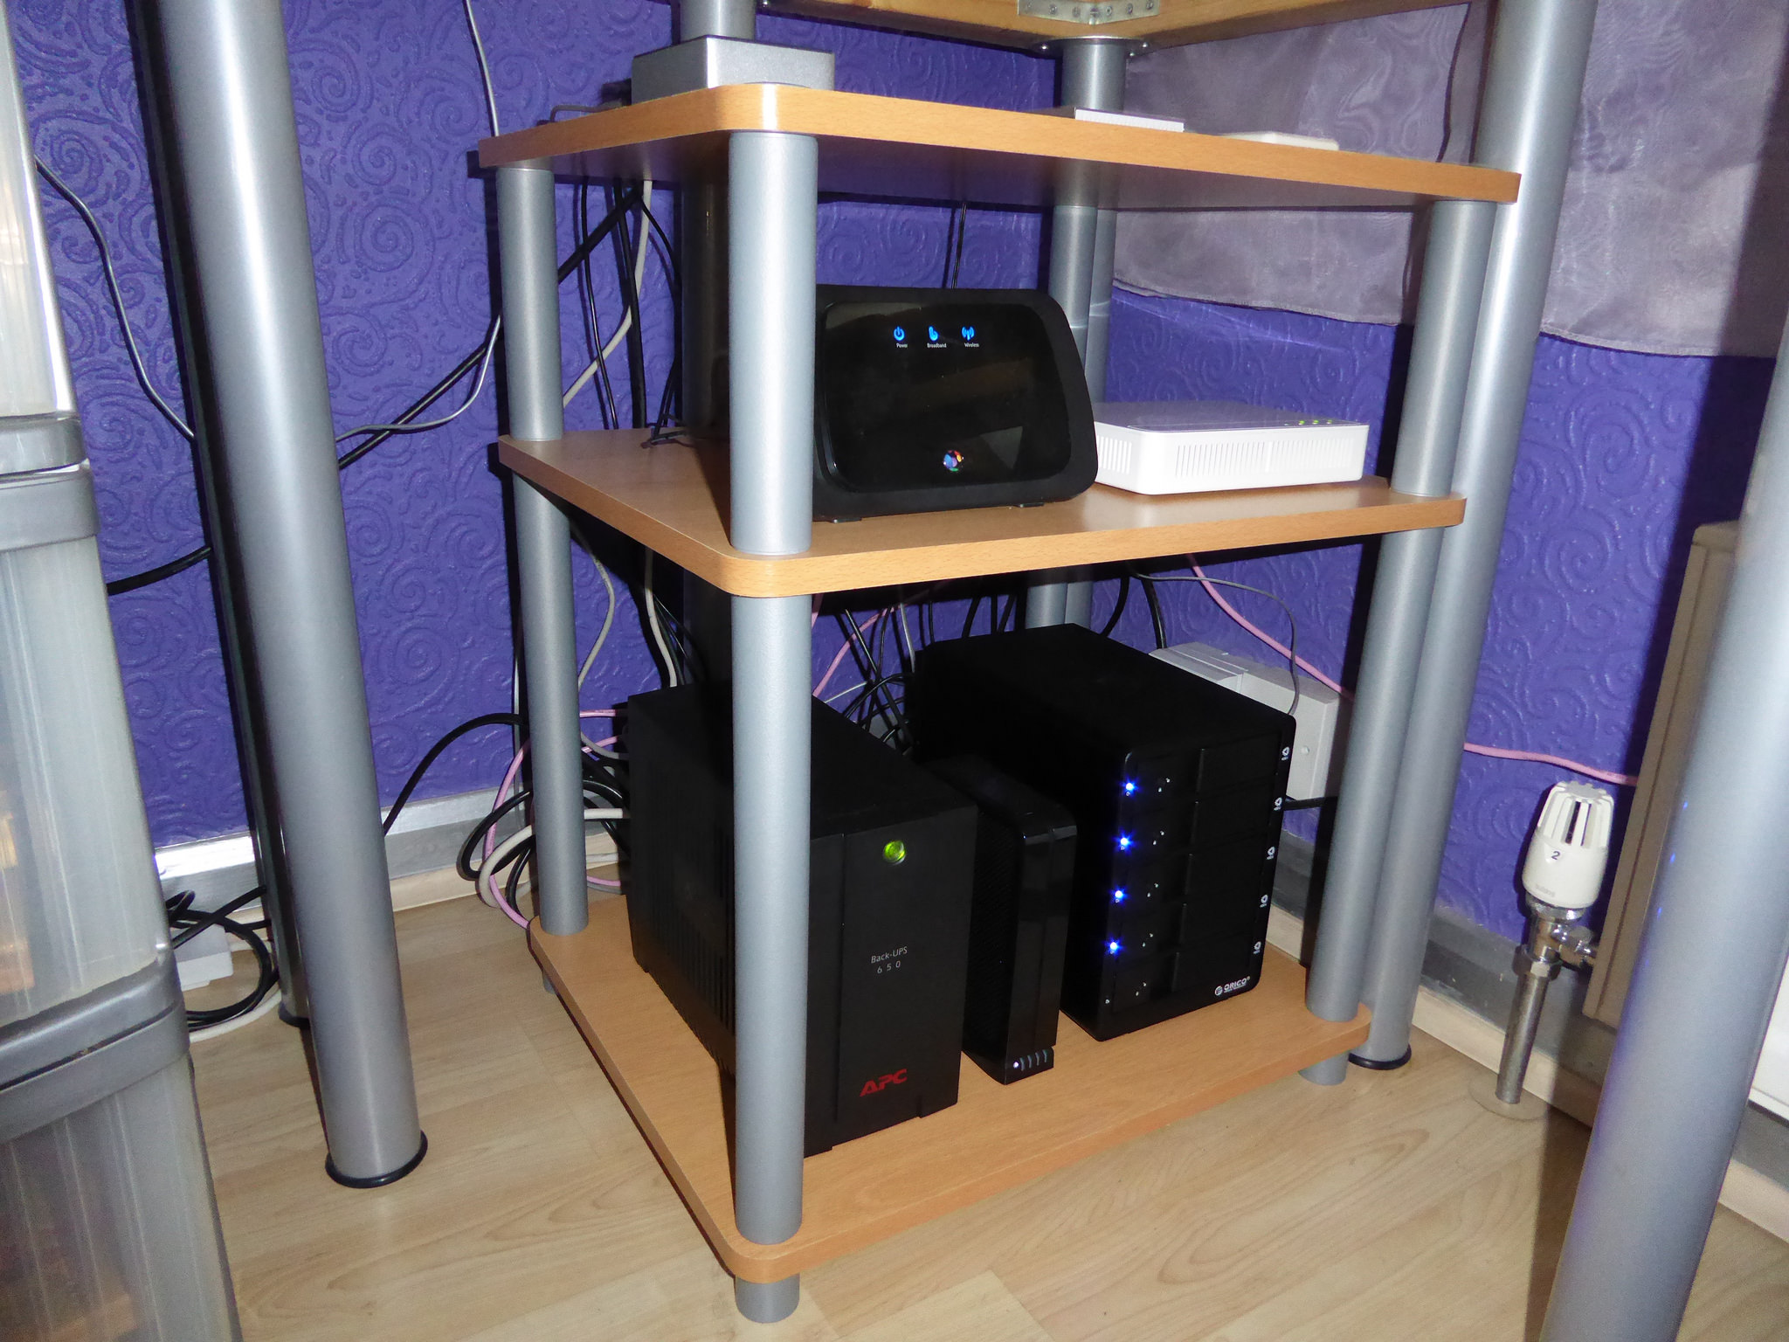
Raspberry Pi 2 Server running Pidora

Slide 8
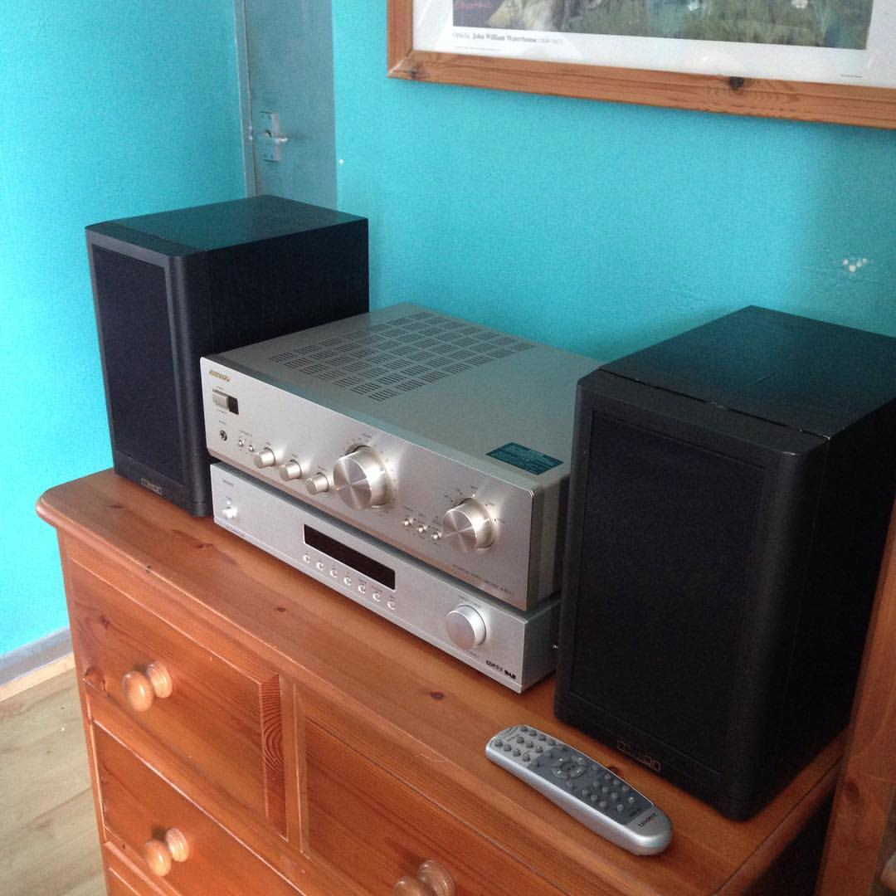
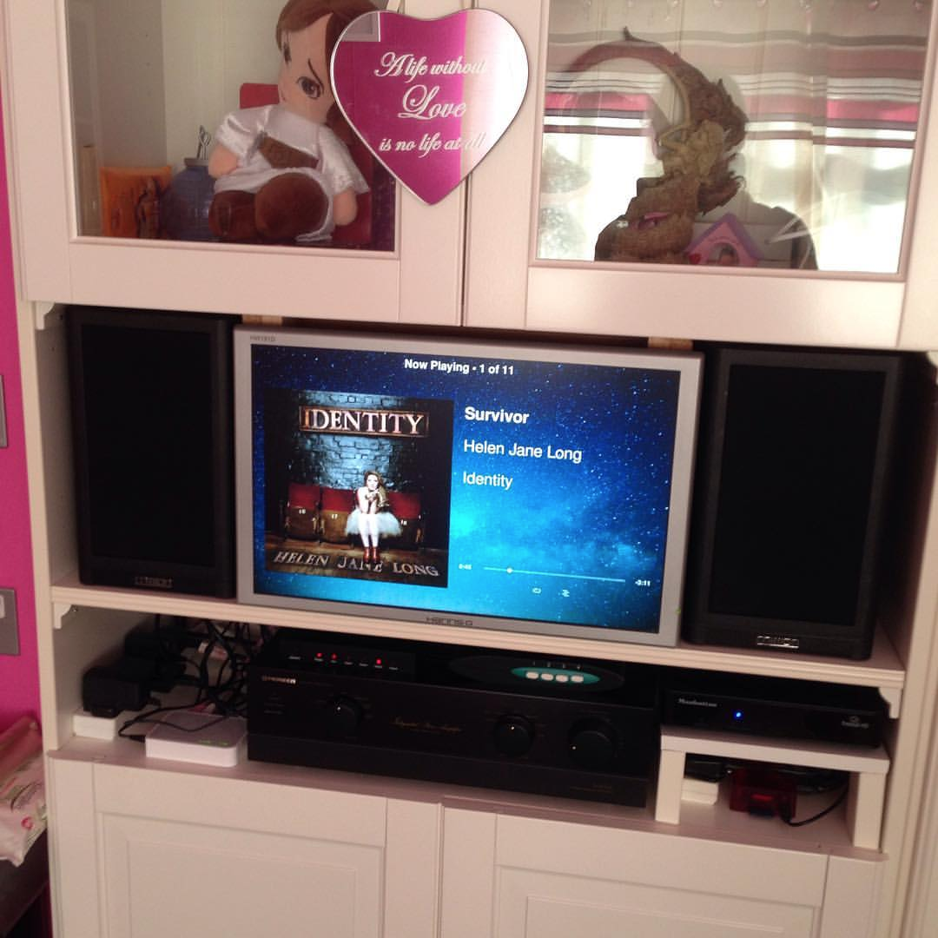
Pi-Fi Music Players
Raspberry Pi + cheap hi-fi off eBay = audio geek heaven,
for a lot less money than a Sonos system!

Slide 9
How to make your Pug bark at home in Shrewsbury from the office!
Simply SSH tunnel into your home network, e.g.
ssh root@brighton.megtek.net -L9000:127.0.0.1:9000
Here's one I prepared earlier... https://www.youtube.com/watch?v=gpLpnb4oM1I
Be sure not to set the volume too high, otherwise you risk giving your wife a heart attack!

Slide 10
How to play music from your Pi in Shrewsbury on your Pi in Nottingham
On the Pi:
sudo raspi-config to force audio to 3.5mm jack
sh setup-tunnel.sh to set up SSH tunnel to Shrewsbury
sh run-squeezelite.sh to run Squeezelite
On the Mac:
ssh ruth@brighton.megtek.net -L9000:127.0.0.1:9000
http://localhost:9000/ on the Mac to control the music

Slide 11
Controlling Easybulb LED Light Bulbs
Easybulb produce Wi-Fi controlled LED light bulbs for your home
I wrote a Java application to run on a Raspberry Pi 2, to allow these to be controlled by a simple HTTP API:
On/Off – either all at once or for a single group at a time (1-4)
White – changes the colour to white for all lights or a single group (1-4)
Disco Mode – turns on/toggles between Disco Modes (flashing/fading colours)
Disco Mode Faster/Slower – speeds up/slows down the flash/fade rate
Brightness – changes the brightness for a single group (1-4)
Colour – changes the colour to an RGB selection for a single group (1-4)

Slide 12
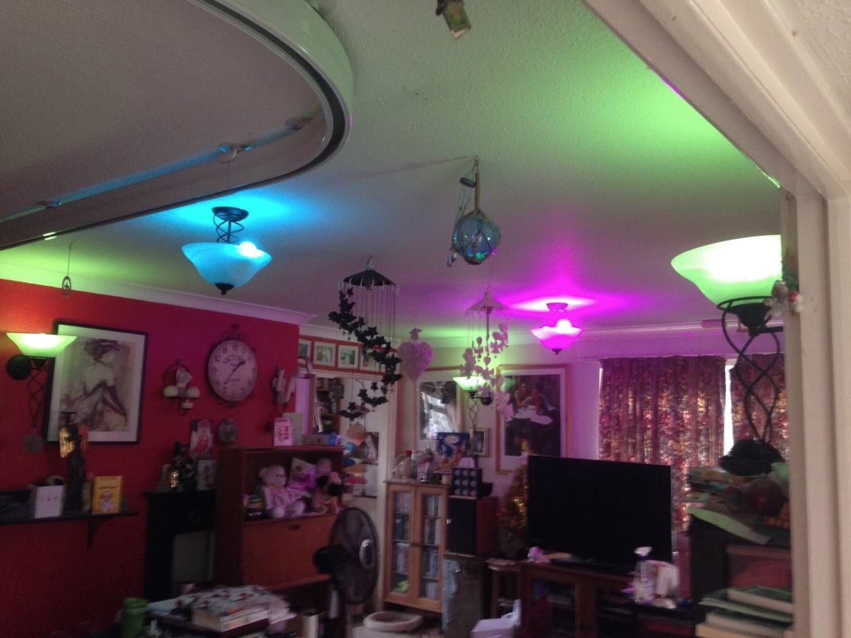
Live Demo – let's FaceTime Sonia
Demo of the Java application running, showing that I can control the lights in my lounge in Shrewsbury from a web browser on my Mac in Nottingham

Slide 13
Advantages of my solution
Security/Reliability – everything stays inside my local network, rather than relying on the cloud – much harder to hack, and it keeps on ticking even if the Internet goes down
Flexibility – the HTTP API just exposes the IoT devices within the local network, so that anything that needs to control them can make the appropriate HTTP calls – rather than dictating how they are controlled
Extensibility – the HTTP API can also be used to integrate other control mechanisms – e.g. Mycroft.AI or Jasper voice control

Slide 14
What's Next?
Security Improvements – use a Raspberry Pi as a special firewalled Wi-Fi access point (with its own SSID) for IoT devices to connect to – quarantined away from the rest of my network – e.g. using the PiPoint project - https://www.pi-point.co.uk/
Reverse Engineering – not all IoT devices have an API available – so I will need to reverse engineer the protocols of those that don't – e.g. by interrogating network packets on the Raspberry Pi access point using tcpdump
e.g. for EasyBulb, tcpdump -XX -i eth0 'udp port 8899'
Integration with Mycroft.AI – Mycroft is an Open Source/Open Hardware project based around the Raspberry Pi 3 for controlling IoT devices via AI voice control

Slide 15
More on Mycroft.AI
This is a project that I backed on Kickstarter around a year ago – I was expecting to get my Mycroft devices back in July but they won't be shipping until later this month now
Example of Mycroft in action - https://www.youtube.com/watch?v=m4L0QfzUeEI

Slide 16
Future Project – Raspberry Pi
Central Heating Controller
Use a number of Raspberry Pi computers to set up my own version of the NEST thermostat
One will have a relay board and will replace the antiquated mechanical dial time switch next to the boiler in the kitchen
One will have a thermostat and will replace the water tank thermostat in the airing cupboard
One will have a room thermostat and will sit in the lounge close to Sonia
Control will be via both a webapp and Mycroft.AI

Slide 17
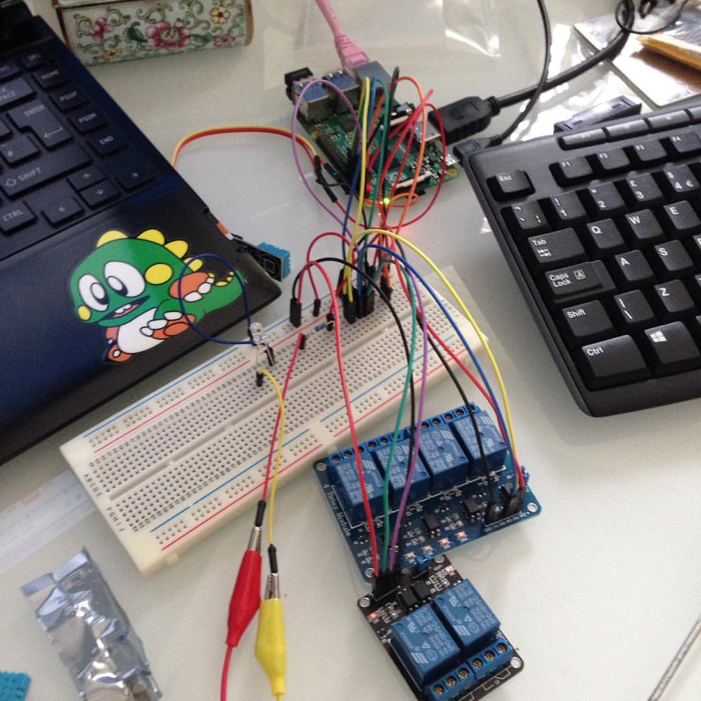
Prototyping the Raspberry Pi
Central Heating Controller
Here's where I was
working on
prototyping the
Raspberry Pi
central heating
controller with a
couple of friends
back in May

Slide 18
Another Future Project - Entryphone and Door Lock for Sonia
Use a Raspberry Pi camera and microphone to create an entryphone to go outside the front door
Add a relay board to the Raspberry Pi to control a magnetic door lock to open the front door
Integrate with Mycroft.AI so that Sonia can operate the entryphone and door lock via voice control

Slide 19
Further Resources
EasyBulb web application on GitHub - https://github.com/ruth-connect/iot-microservices-spring-boot
EasyBulb – http://www.easybulb.com/
Mycroft.AI – https://mycroft.ai/
HiFiBerry - https://www.hifiberry.com/
Squeezelite - https://github.com/ralph-irving/squeezelite
The Pi Hut - https://thepihut.com/
Connect Group – http://www.connect-group.com/
Hacking the Internet of Things – http://iot.ruthmills.me.uk/
Diary of a Linux Geek Girl – http://geek.ruthmills.me.uk/

